Slide 1

Showcase for Proxy
Software Architectures and Database Systems
By Maciej Penar ©
mpenar@kia.prz.edu.pl

Slide 2
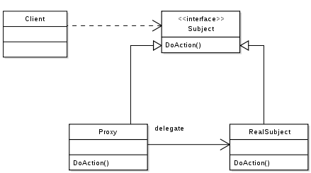
Class Diagram
https://en.wikipedia.org/wiki/Proxy_pattern#/media/File:Proxy_pattern_diagram.svg

Slide 3
Why
Perform additional task within the contract
Access control (i.e. authorization / validation / cache)
Great for providing fallback mechanism (similar to Chain-Of-Command)
Great for decoupling the layers of logic
Simple code goes to batsh*t-crazy complex logic
… which You are able to manage

Slide 4
Example
Show some goodies now

Slide 5


Slide 6
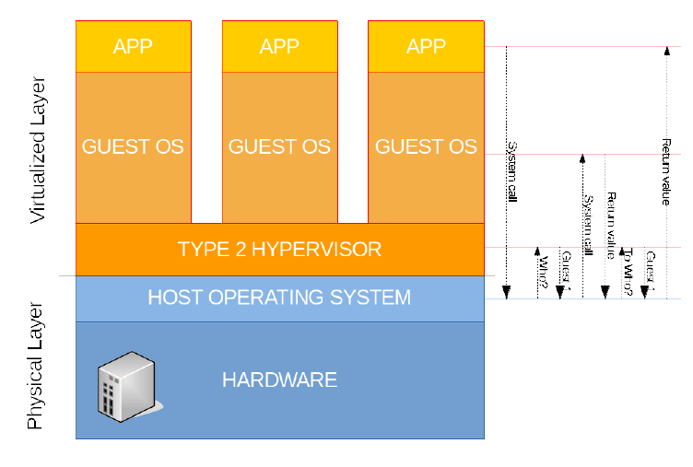
Virtualization – type 2

Slide 7
Virtualization
Virtualbox = type 2
Hyper-V = type 1

Slide 8
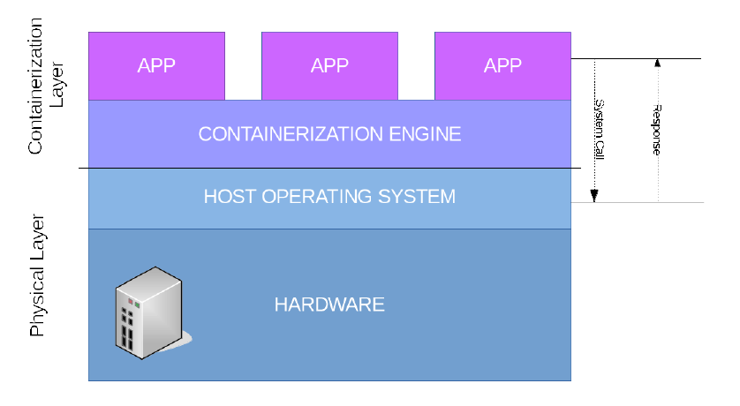
Containers

Slide 9
That’s all for now

